Slide 1

VirtuFS: Virtual Storage Management
VirtuFS is a lightweight, Bash-based tool for virtual storage management and automation. It simulates drive-like storage using directories, offering mounting, encrypted backups, access control, and logging via a simple CLI.

Slide 2

Who Benefits from VirtuFS?
DevOps Engineers
System Administrators
Streamline storage tasks and automation in development pipelines.
Simplify drive management and secure backup operations.
Linux Automation Learners
Secure Storage Experiments
Explore practical Bash scripting for system tasks.
Test encrypted backup and access control mechanisms.

Slide 3
Key Features of VirtuFS
1
2
3
Virtual Drive Management
Secure Backup System
Automated Backups
Create, delete, mount, and unmount drives with ownership validation.
Encrypted backups (AES-256), timestamped versioning, and safe restore.
Cron-based long-term, real-time short-term, and automatic cleanup.
4
5
Access Control
Logging & Monitoring
Change ownership, set custom permissions (chmod), and view metadata.
Colored console output, centralized logs, and health reports.

Slide 4

Chapter 3: Structure & Setup
VirtuFS Directory Layout
Upon first execution, VirtuFS establishes a clear directory structure:
~/VirtuFS/ ├── data/ │ └── drives/ # Virtual drives ├── mounts/ # Mounted drives (symlinks) ├── backups/ │ ├── encrypted/ # Encrypted backups (.enc) │ └── plain/ # Temporary decrypted archives ├── logs/ │ └── virtuFS.log # System logs

Slide 5
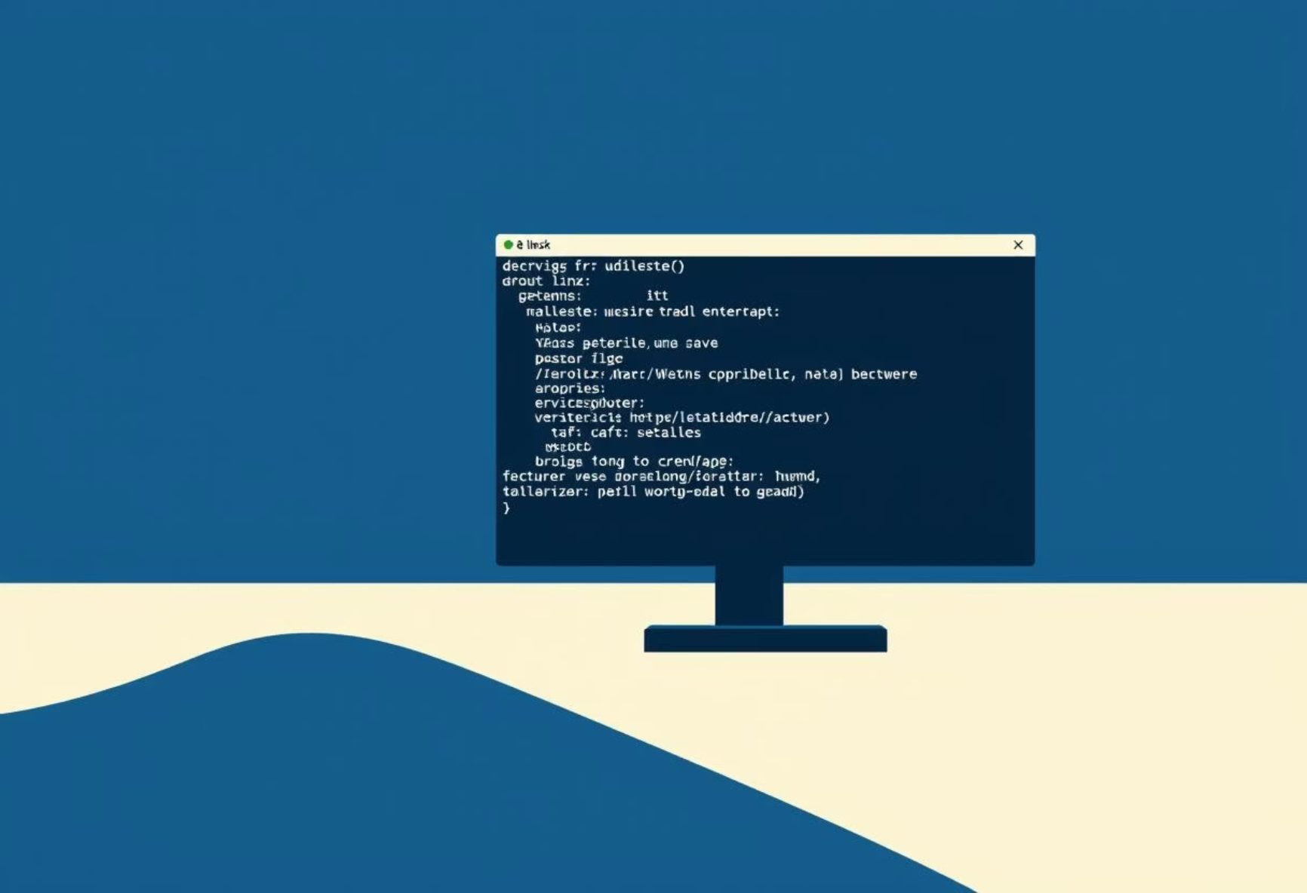
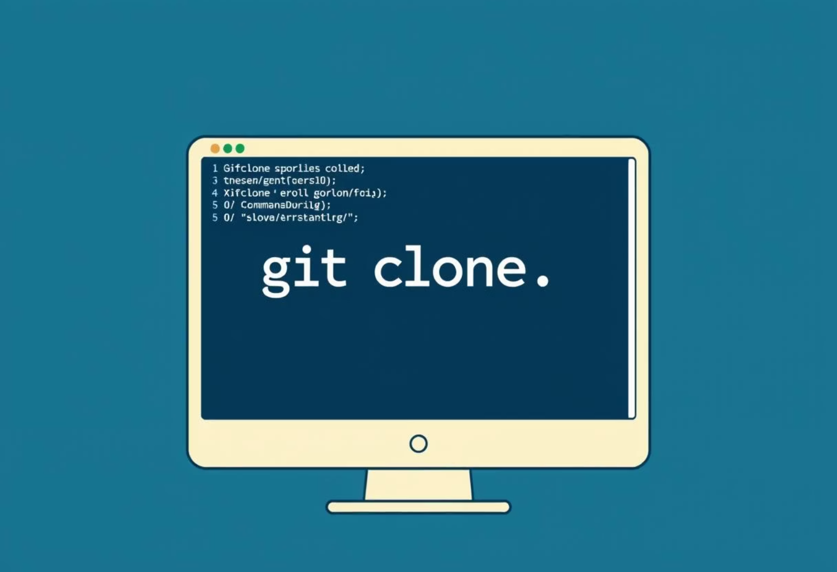
Installation Requirements & Steps
Requirements
Setup Steps
Linux system
Clone the repository, make the script executable, and verify:
Bash shell
tar, openssl, cron
git clone <repository-url> cd VirtuFS chmod +x virtuFS.sh ./virtuFS.sh --help
sudo (for ownership changes)

Slide 6

Encryption Password Management
VirtuFS uses a predefined encryption password. For production, enhance security:
Environment Variables
Secure Prompt
Store passwords securely outside the script.
Implement interactive password entry.
Secrets Manager
Integrate with tools like Hashicorp Vault.

Slide 7


Drive Management & Backup Operations
Drive Management
Backup Operations
Basic commands for virtual drive control:
Create and restore encrypted backups:
./virtuFS.sh drive create mydrive ./virtuFS.sh drive delete mydrive ./virtuFS.sh drive mount mydrive ./virtuFS.sh drive unmount mydrive
./virtuFS.sh backup create mydrive ./virtuFS.sh backup restore mydrive /path/to/backup.enc

Slide 8
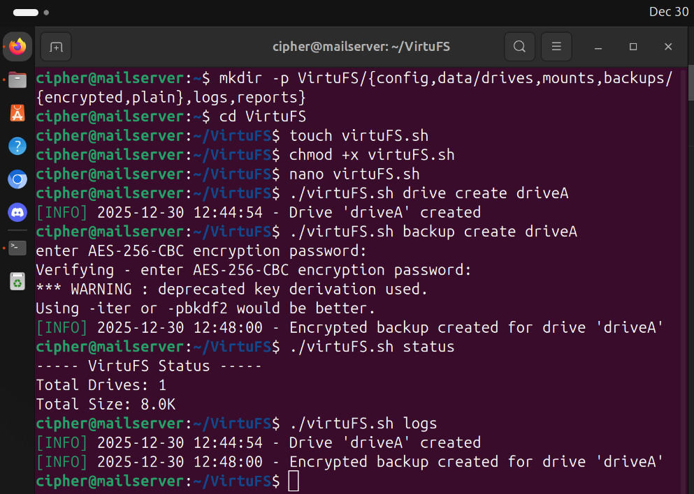

Slide 9



Automated Backup Strategies
Cron-Based Backup
Cleanup Old Backups
Short-Term Continuous Backup
Schedule backups at specific intervals (e.g., daily at 2 AM).
Automatically delete backups older than a specified duration.
Real-time backups with retention policies (e.g., every 60s, retain 10m).
./virtuFS.sh auto-backup setup mydrive "0 2 * * *"
./virtuFS.sh auto-backup cleanup 86400
./virtuFS.sh auto-backup short-term mydrive 60 600

Slide 10
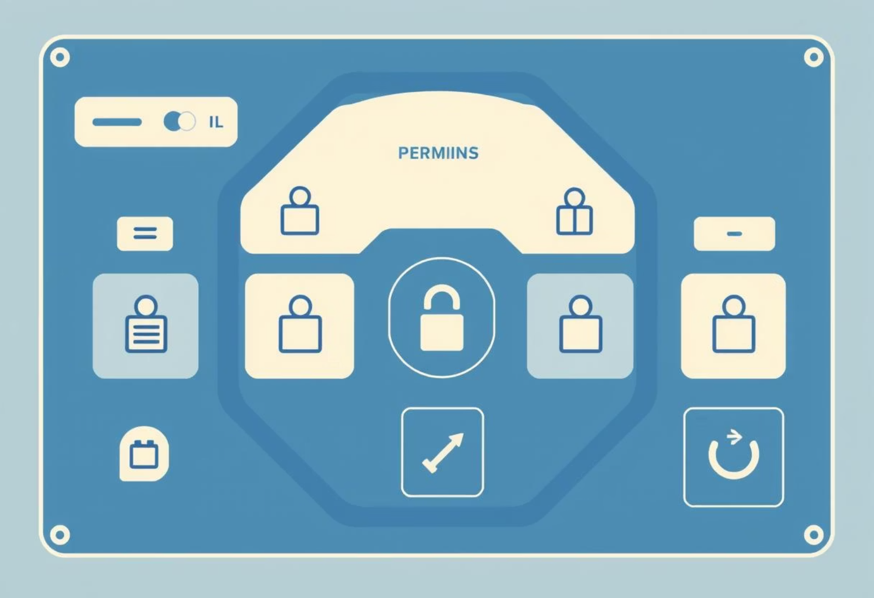

Access Control & System Health
Access Control
Monitoring & Health
Manage drive ownership and permissions:
Check system status, health reports, and view logs:
./virtuFS.sh access owner mydrive username ./virtuFS.sh access chmod mydrive 755 ./virtuFS.sh access info mydrive
./virtuFS.sh status ./virtuFS.sh health ./virtuFS.sh logs

Slide 11
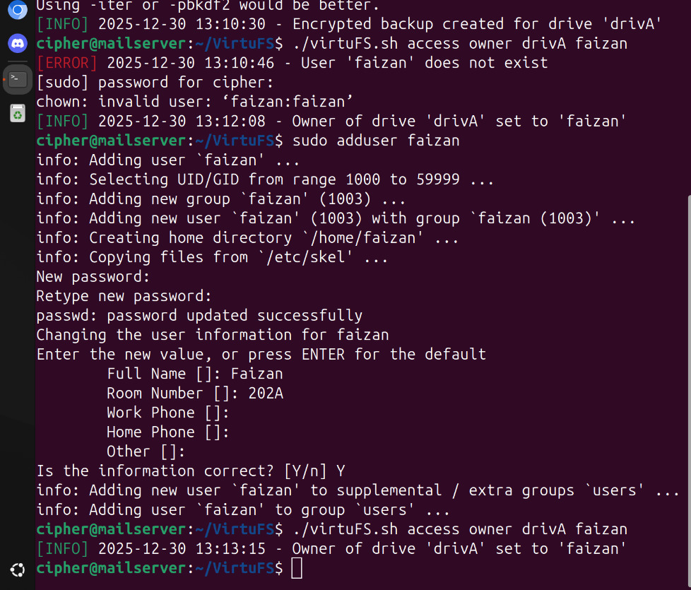

Slide 12
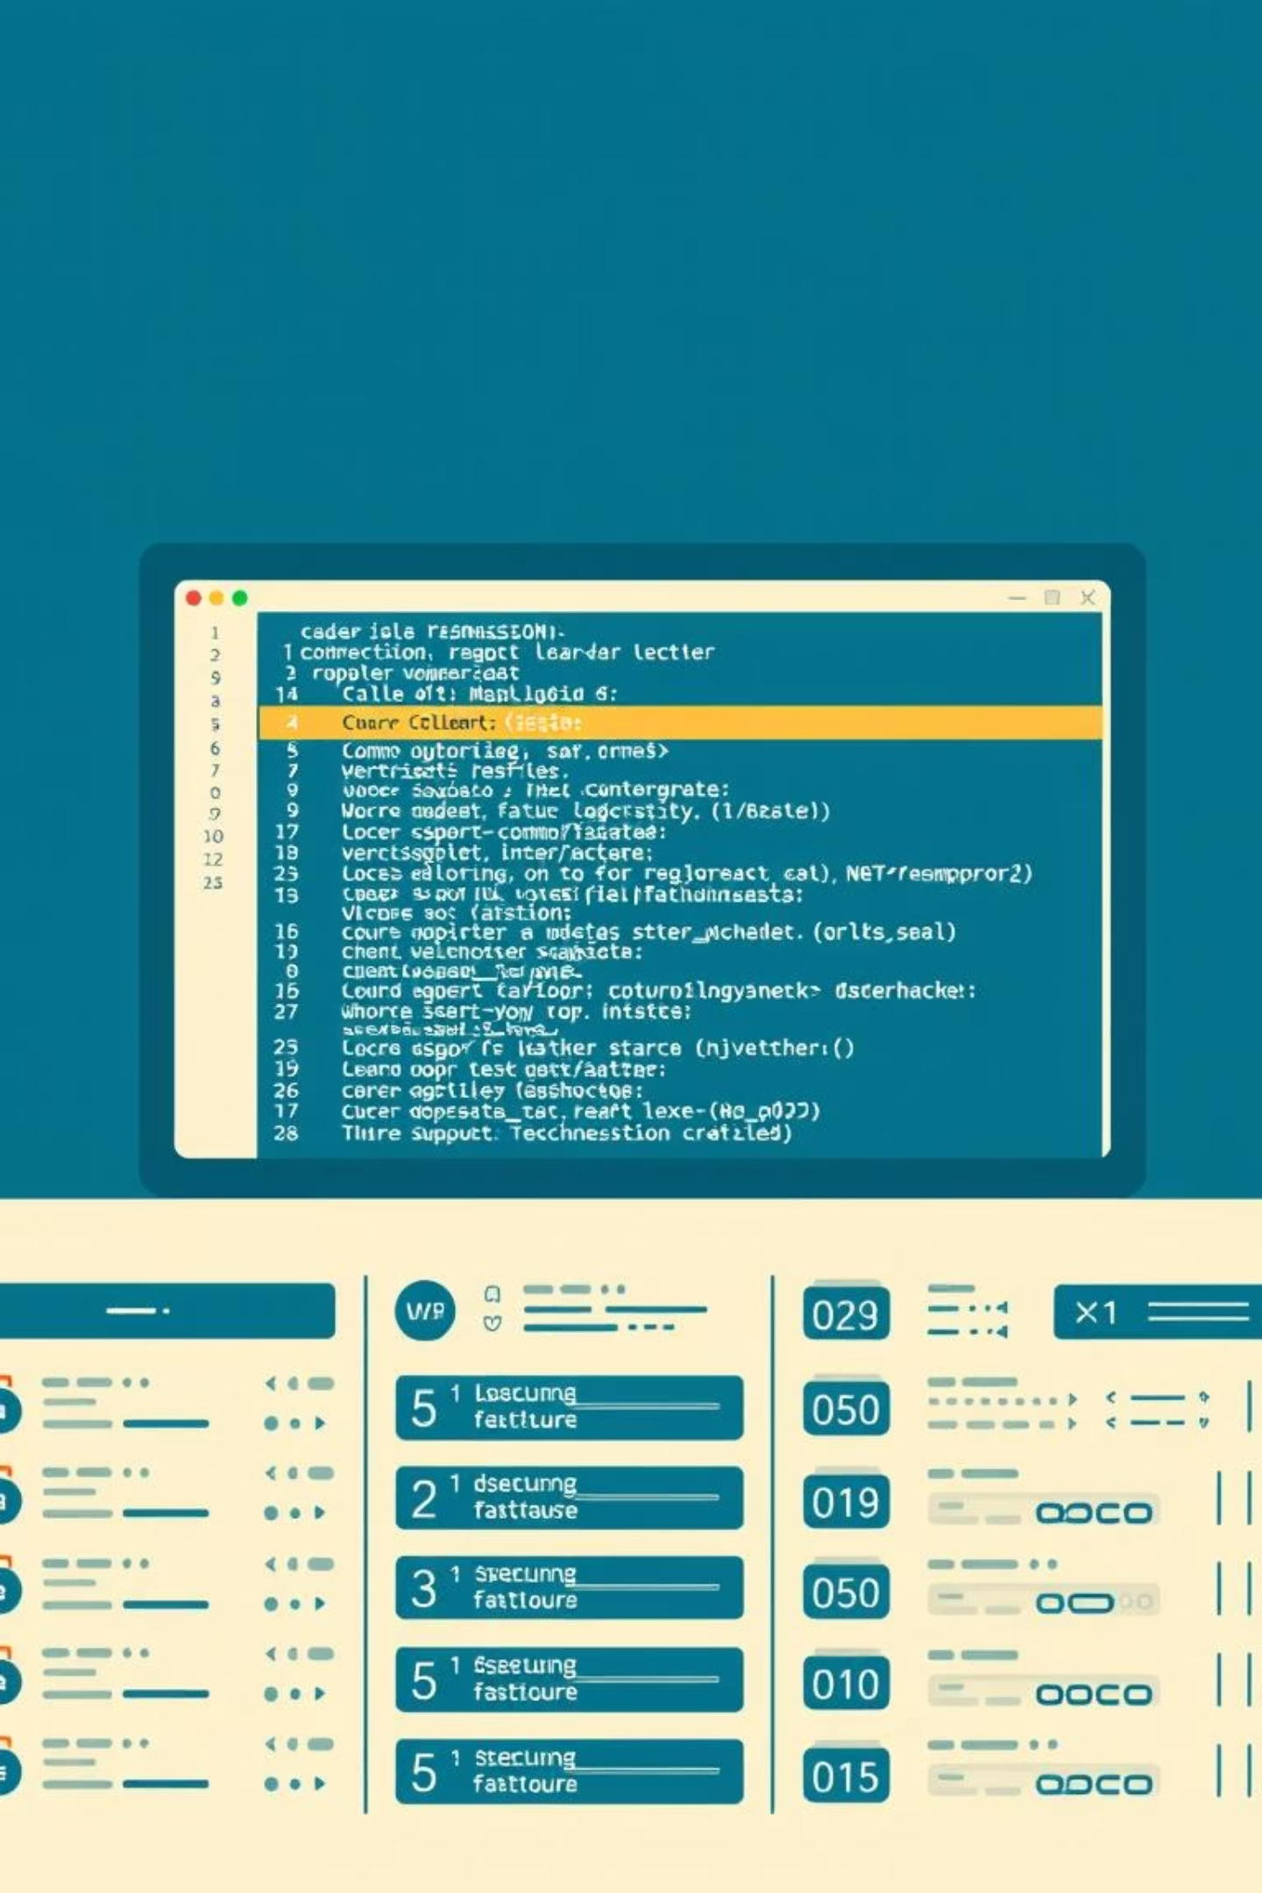
Comprehensive Logging for VirtuFS
All VirtuFS operations are meticulously logged to ~/VirtuFS/logs/virtuFS.log.
INFO
WARN
Normal operational activities.
Destructive actions or cleanup processes.
ERROR
Permission issues or runtime failures.

